Slide 1
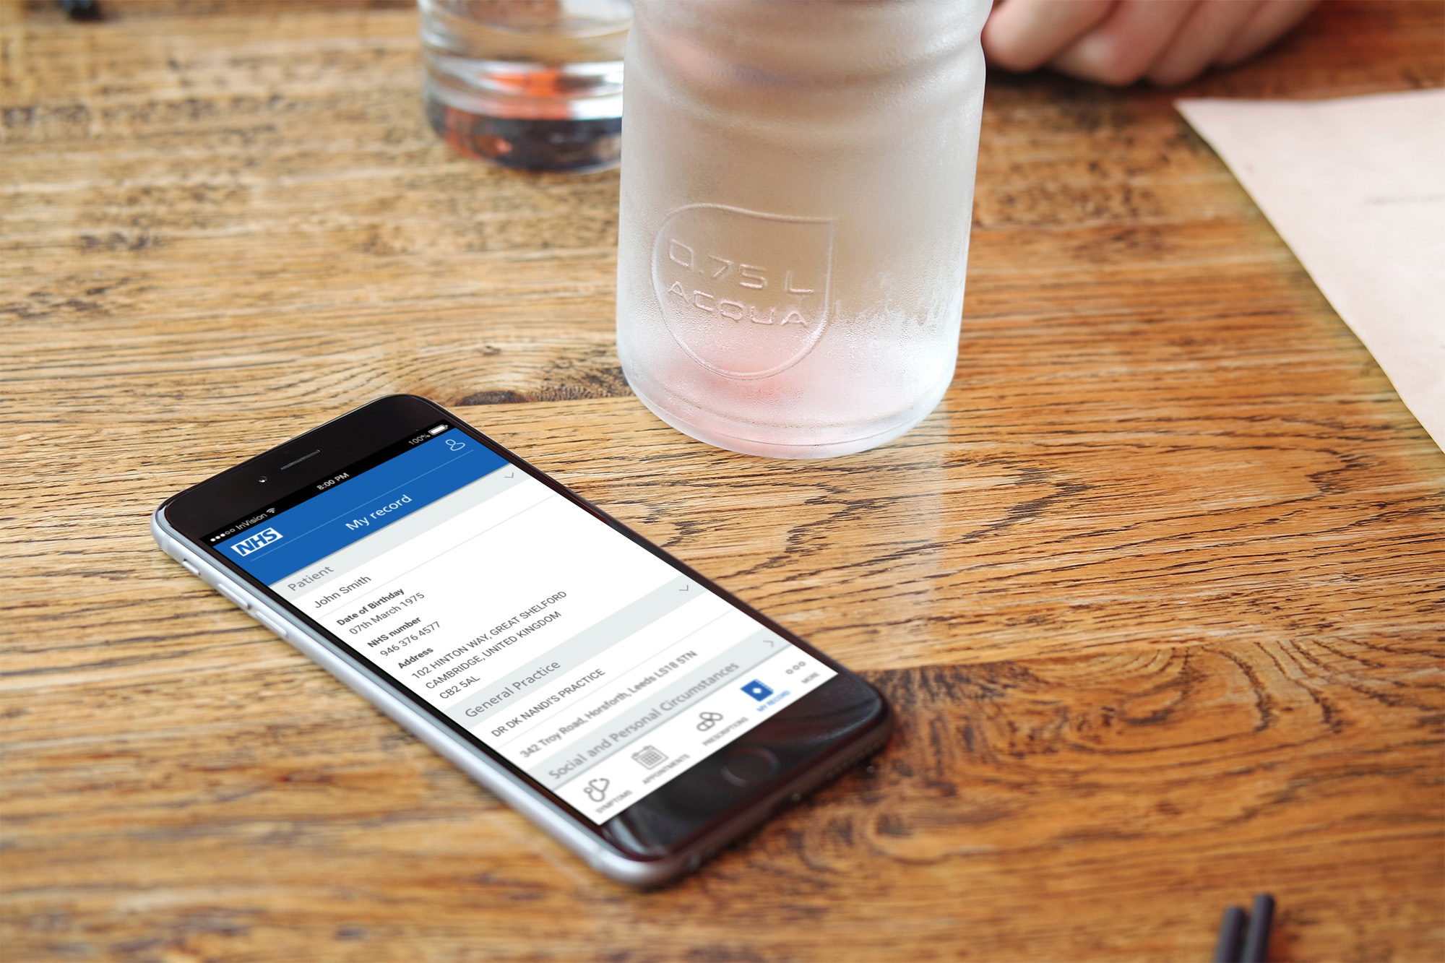
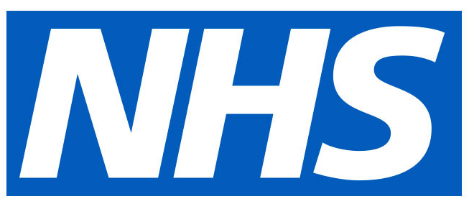
Technical Vision for Account & Proxy Proposed MVP for Digital Proxy Service September 2022
Notes:
Quick back ground on me
Architect in Citizen Experience
Pre architecting..
Been a Developer
Managed Dev teams
Private sector and contracting for a long time
Only been in NHS E 6 months
A year in a trust before that
First AEG, so bear with me.!

Slide 2
What is proxy?
IT / Tech
"An intermediary between a client
requesting a resource and the server
providing that resource,
potentially masking the true origin of the
request to the resource server."
Notes:
Starting off with a few different definitions of “Proxy”
As Proxy and Account are plagued by confusion over words and definitions

Slide 3
What is proxy?
OED
"Authority given to a person to act for someone else"

Slide 4
What is proxy?
NHS
"Allow people to act on behalf of the
patients and dependents they care for,
and to allow users of NHS digital
services to share their records with
those they trust to act on their behalf"

Slide 5
Key points to note:
NHS Definition has 2 parts – physical and digital
We don’t want any “masking of true origin” when talking about proxy access in NHS
Notes:
Key points to note are:
NHS Definition has 2 parts
Don’t want to have masking of true origin in NHS Proxy
From a tech background…
this makes me question, should proxy really be called proxy?
due to the confusion that most tech people associate proxy with masking of true origin

Slide 6
Why need proxy?
Citizen
Make life easier for them (proxy is often needed at stressful times in their life)
Staff
Reduce / Remove the burden of having the responsibility of having to validate and then enforce Proxy decisions manually.
Notes:
Citizen:
Making it easier for them
Staff:
A Heavy burden
Legal questions if they get it wrong
The source of truth is outside of the NHS, so we should be able to use that directly, and without human intervention

Slide 7
What / When can proxy happen?
A user has requested it, and when medical systems have been updated with those user assignments (ie GP systems)
Legal enforcements – Power of Attorney – even if health IT systems not been updated with it, the PoA paper work can be shown.
Other legal relationships – Parent Child etc
Notes:
At the moment, the request process involved lots of paper, and staff validating it manually
And it needs manual updates to IT systems that hold the data

Slide 8
Aims of this presentation
Proxy
Focus was intended to be on “MVP” for Proxy
Account
Now contains “bigger picture” possible vision for what account could provide
Not just the “data” but how the access to that data could be controlled
Currently very subjective “possibilities”
Request for Comments - please!
Notes:
Focus initially was on Proxy, and outlinining the next phase and MVP
It still does do this
However, its outlining visions for account
And how decisions on account can better support the concept of Proxy
VERY early days subjective thought,
So this really is an RFC to the community
To help understand what is in flight else where, and where there is overlap
It’s been very hastily put together, so I am going to diverge off into different rabbit holes along the way.!

Slide 9
What’s needed to support Proxy?
Identities
Relationships
Roles
Resources
Proofs
Validation & Enforcement
Notes:
What are the key areas that we need to have for digitally allowing the “Authority to Act for someone else”

Slide 10
What in “Proxy” should maybe live in “Account”
Suggest key parts of what is needed for proxy, really becomes part of account.
The supporting tech that is needed for keeping track of who is allowed to do what.
Notes:
Blur between account and proxy
They live side by side in CE but over lap

Slide 11
Account, Account Endpoints & Proxy
Policy Enforcement
NHSLogin (IdP)
Authorisation
Account
ABAC / RBAC / UMA
Resources (APIs)
Proxy
Verified Creds
Account Data / Endpoints
Proxy Validation Service
Notes:
At the moment, Account it just talked about as “the data” – and making data easier to access
(let me just get the laser pointer….)
Proxy, at the moment, is the proving of relationships, storing those relationships, controlling data based on the relationships…
I’m proposing that this needs to be widened into the controlling of access to that data
This is then “The Account” which is supporting access to “The Account Data”
Proxy then becomes a service that just updates the “Account” based on the proofs it receives

Slide 12
“Account” - the supporting tech for controlling access to “Account Data”
Account Unique Id
Users
Idps
User -> Roles
NHS Number(s)
NHS Login
--------
Name
NHs no
UserId
Roles
User -> Clients
UMA – the who
Clients
User / Roles -> Scopes
Clients -> Scopes
Scopes
Account Data
Notes:
Going into “Account Now”, not proxy –
but key parts of this functionality the moment are required for proxy
Doing straw polls here, most consider this out of scope for “Account” (and Proxy!), but its core to supporting the proxy work
Account needs to be not just about the data, but about controlling access to data
Its about the authorisation
“The Account” is “The container”, (not in a docker sense), protecting “the account data”, (and supported by the very external NHS Login for identity)
The Account Data is data linked to an NHS Number
The Account is linked to NHS Number
But it contains:
The users (linked to IdP) that can be given access to data exposed by that account
And the roles and permissions assigned to them
And you’ll see this goes on to support the core of what is needed for proxy

Slide 13
Separating the who from the what
Users
NHS Number(s)
Idps
NHS Login
--------
Name
NHs no
UserId
Splitting the NHS Number away from the Identity of the user
Account represents “the data, the roles, the clients” that are linked to NHS Number
The users that are added to account have the access for things to do with that NHS number
Just because you NHS Login contains an NHS Number, NHS Account should not give you access to its resources
(The (s) in NHS Number(s) due to some people ending up with multiples (FUBAR))
Notes:
Splitting the NHS Login provided NHS Number away from account supports proxy
Just because you NHS Login contains an NHS Number,
NHS Account should not give you access to the resources it protects

Slide 14
NHS Account – liken it to an Office 365 Tenant….
Domains
NHS Number(s)
Primary Domain
NHS Number
Org Contact Details
Contact Details for NHS Num
Roles
Roles
Users
Users
Guest Users
Guest Users
Notes:
Guest users – exists in another tenant, but can be added to others and be given access to resources in them
Also had Account “unique id”, that is equivalent to the tenant Id

Slide 15
Account / RBAC / Proxy - sounds great
But what resources / data is it to protect?
The best authorisation platform in the world is only useful if resources use it and enforce the rules

Slide 16
The NHS Data Silo Sprawl
The illusion to the public that there is “The NHS” leads to assumption that there is “The Data”, which ultimately leads to their illusion being quickly shattered, and then comes their frustration at why everything is so hard for them.
Same thing happened at MS as they started moving to cloud – it wasn’t a unified experience.
Which is why they developed MS Graph
Notes:
The fact that we are referred to as “The NHS”, I think, is an Achilles heal when it comes to citizen expectations.
But its not a unique situation

Slide 17
What is MS Graph?
Graph enables you to access, combine, and build workflows and applications with data across a broad range [of] Services.
Second, Graph provides a broad, straightforward, and consistent set of API endpoints for your data
Access and analyse all of that data through a single, consistent API layer with common authorisation that is straightforward to address and simple to use.
Notes:
What is graph:
Broad range of services
Consistent set of apis
Common authorisation

Slide 18
Then liken “NHS Account Data” to Microsoft Graph…
Single domain, multiple sub endpoints
Single Authorisation & Scopes
On board existing service (think sharepoint, exchange online etc, they did have separate APIs but the “Gateway API microservices” were build to tunnel those through MS Graph)
New services directly exposed through graph
E.g…
https://graph.Microsoft.com/v1/me/profile
https://account.nhs.uk/v1/me/profile
Notes:
Sorry for the MS heavy analogies here,
But, we just likened account to a 365 tenenant
So now liken the NHS Account “Data” to Microsoft graph
On the URLS – key point to notice here is “me”

Slide 19
The Ideal Account: Single API Endpoint for all Citizen Services
E.g. Address change, email change, wareables data etc
POST /mynhs/me/profile/address/ {house:’1’,street:’the street’ ……..}
GET /mynhs/me/health/bp/latest {date:’1/1/22’, Sysolic: ‘100..}
Citizen Friendly Data Schema – Not FHIR.!
Notes:
Ideal account data:
Single api endpoint
Common Authorisation
Data Schema – Should be Citizen friendly – FHIR is not Citizen friendly
Its not needed here, a well docuemented OpenAPI v3 (swagger) is much better optino

Slide 20
How this supports proxy. Proxy access is just…
POST /mynhs/{OtherId}/profile/address/ {house:’1’,street:’the street’ ……..}
GET /mynhs/{OtherId}/health/bp/latest {date:’1/1/22’, Sysolic: ‘100..}
Notes:
Its not “me” any more, it’s the unuque id of a user in another account.
Client would request oauth token from authorisation server, specifying the “Account unqique id” and then specify the unuque id of the user

Slide 21
Stop talking about integration with… NHSApp, UK etc.
“Account Data” tech focus should be API, with standard auth scopes:
NHS App onboards with Account to use APIs
As does, NHS uk…
As does, Bob Smith who wants to call his own account APIs through Postman on his home PC
Notes:
Next few slides are side notes
This one highlights a problem I keep coming up against

Slide 22
Client Control – global / local / role / attribute controlled
NHS can globally control “clients” that any user can choose “add” to their account
A User can onboard cients to their own “Account” ie supporting Bob adding client with callback https://localhost but only available for his own Account
Or NHS Allow “Beta” apps to “Accounts that are “Beta Tester enabled”
Notes:
This is about the “Clients” that can be used on the platform
NHS Approved clients can be used in the scope of any Account
User approved clients can only be used in the scope of their account

Slide 23
Empowering our Citizens to Consent – THEY EXPECT IT!
Treat NHS Account data as belonging to the Citizen
choose who and what and when
Imagine….
Citizen approves Apple Health to Write to NHS Account Health
Then….
Citizen approves the NHS Digital Health check to read most recent blood pressure result and a weeks worth of step count, but not alcohol consumption
Notes:
Account gives us the opportunity to empower our citizens to have granular consent
We are talking of aggregating and making data easy to access
So its our chance to ensure the public that all of the sharing only happens with their consent
Suggest that even “we” the nhs, cant call these APIs with our client apps being approved by the citizen using them

Slide 24
NHS Login?
NHS Login id the external IdP for Account
New endpoints don’t onboard with NHS Login, they onboard with Account, with scopes defined in account for that service as part of onboarding
https://account.nhs.uk/v1/profile....
https://account.nhs.uk/v1/health/wearables-data/....
https://account.nhs.uk/v1/appointments/....
https://account.nhs.uk/v1/health/gpdata/.....
https://account.nhs.uk/v1/messages/....
Notes:
NHS is just the Idp
Account is doing the authorisation
And new endpoints on board with account, not NHS Login

Slide 25
account/proxy abac/rbac Policy Enforcement
Attribute Based Access => Opens more possibilities that just roles
Alice allows Bob full access to her Account only when rules are met:
In Group: “My Proxy Delegates”
Used MFA
Currently In UK
Using Super NHS App v2
Only when she hasn’t logged in in 24 hours
When her “Status” is “Admitted to Hospital”
Notes:
That’s the quick dive over for what account needs to do to support proxy
Back to proxy…
Question in “Legal proxy scenarios” over when people should have access
For example, with Medical Power of Attorney, you may have it, but it can only be used if the person is “”impaired”
In theory – data from account can be fed back in to controlling access to the resources it protects
Moves to the attribute based model used in Zero trust Authorisation platforms

Slide 26
“MVP” Focus – 2 “Strands”
Citizen “Request to Give Proxy” online form
VC’s & UMA
Data: GP Data
Citizen to request another citizen to be a proxy for them.
Verify both parties want it.
Why?
Make it easier for Citizens to start
Centrally record proxy requests
Help with future Policy change
But…
Staff Still need to update Access Controls on the GP System to “Give Access”
VC’s
Work With MOJ on us both issuing VC’s and validating them
We have an IdP nhs login
We issue NHS No VC
They issue a Medical PoA VC Presentation
We validate it
UMA
PoC service for updating simulated Authorisation Server UMA rules based on validated VC’s received
Notes:
Whats in the immediate future for Proxy? 2 Strands
Strand 1:
One is looking at “quick win” – with existing “Core tech”
Its about digititising the request from a Compent person for another Competent Person to have access to their primary care digital records
Not about “Account Data”
But still a manual process of updating the GP system
Strand 2:
How to support automatic access to “Account Data”
Verifiable Credentials – working with other agencies / organisation
Its about Digitally proving Relationships that have their “Source of Truth” outside of the NHS – if we can prove these digitally, the burden is taken off our staff
UMA – User Managed Access
This is an extension to oauth, that adds in the concept of the resource owner being able to consent to who can access their resources, not just what
Going to cover UMAs and VC’s in a little more detail shortly

Slide 27

Strand 1: What can we aim to deliver in 2023?
Ambition: We’d like to propose deploying an MVP proxy service for adults to adults with mental capacity and parents* for their children in June 2023. This would be a hybrid service, still partially reliant on the general practice (rather than fully digital) but would enable the team to deliver some of the elements required for a future proxy service to the benefit of users and practice staff, and support the team in fully addressing the intricacies of this service before rolling out more fully..
Notes:
Key points
Adults to Adults with Capacity
Hybrid – still has manual process
Support team in user research and support work on policy changes

Slide 28
Strand 1: Requesting Proxy access MVP
Proposed MVP deliverables (within early adopter pilot sites nationwide):
A service for adults who require access to other adults’ records (with mental capacity)
A service for parents who need access to their children’s records within the same practice
A digital proxy service policy for adults/adults and parent/child, including the rationalisation of the proxy service process for 11-16 year olds
Standardised, digitised and pre-populated request forms - bringing consistency and reducing the burden of set-up on practice staff
Dedicated information web pages on NHS.UK for the pilot sites, which could then be extended as the pilot is rolled out.
Notes:
Key deliverables:
Web form
Logged in
Pre load some data from NHS Login
Start raising awareness for digital proxy options

Slide 29
Requesting Parental Proxy access MVP
Notes:
Quick flow for this strand 1

Slide 30
Granting proxy access by an adult with capacity MVP
Notes:
Quick flow for this strand 1
Benefits citizen in making application digital
Benefits the staff in that they know both parties are happy with this
BUT still a manual process to update IT system to honour the request

Slide 31
What will continue to be developed alongside this?
Alongside the pilot we will continue to work towards a more fully digitised solution:
Strand 2 - PoC (see next slides)
Information Governance and legal work to develop a trust and liability framework for the credential data flows
Work to expand the use cases to adults without capacity, through involvement with the MoJ
Determine how the service can be delivered through the NHS Account
GP IT / GP Connect – understand what is in the pipeline for proxy considerations directly in GP IT systems
Notes:
Along side the Strand 1 pilot is additional ongoing
IG implications
Working with other Agencies
Interaction with Account
Interactions with GP IT

Slide 32
Strand 2: PoC - Removing the manual processes
Alongside the work with GPIT, need to run in parallel for longer term strategic approach
Prove “automated” process end to end
Digital Verifiable Credentials
User Managed Access
Work with MOJ on Power of Attorney VC’s
Simulate GRO Birth Cert / Marriage Cert (GRO LEV Service data)
Notes:
Strand 2 Key points
Proving external Relationships, and validating them
Enforcing rules based on these proved relationships
Allows a fully automated process for “Authority to act on anothers behalf”

Slide 33
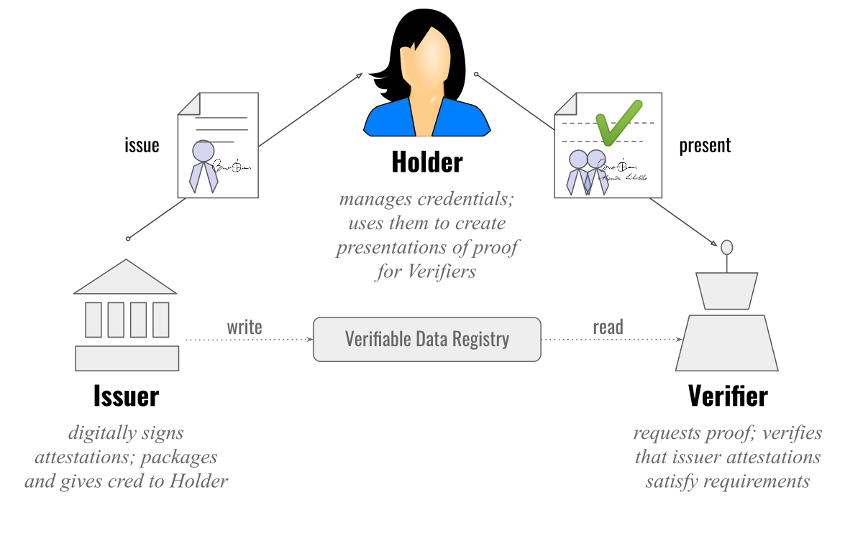
Strand 2: Digital Verifiable Credentials (VC)
Proving Identity
Proving Relationships
Issue NHS Number VCs
Simulate GRO issuing VC of Birth Cert
MOJ issuing Medical PoA VC Presentations
Issuer: MOJ
Issue/Claim(s): Medical Power of Attorney
Holder: Alice (Bobs daughter)
Subject: Bob (The parent, given PoA to Alice)
Verifier: NHS Proxy Auth Service
Notes:
Think of you covid pass – its digital proof that can be validated that you have had covid vaccinations
Example – Bob has given Alice Power of Attorney and its issued as a VC
Key tech terms – Issuer, Claims, Holder, Subject, Verifier
Key point of VCs is they can be combined and then presented to give more content and more proof in different contexts
For POA
MOJ take 2 “Identity” VCs and then
Issue a new VC which proves the two identitys have a relationship of POA

Slide 34
How can VC’s be used for “digital” Proxy interactions?
Accessing Digital Medical Records:
Bob has given Alice Power of Attorney, its been issued digitally as a VC by MOJ
Bob hasn’t accessed NHS Account and hasn’t set up Alice with any user roles there
She uses Proxy Service App, and it requests the VC
She proves her identity and that she holds a VC for the PoA (all from Dig Wallet on device)
Proxy service directly updates Bobs NHS Account Users and Roles
Alice now has access to Bobs data
We’ve taken external proofs, and applied Authorisation rules based on them
Notes:
How can a “Proxy Service” work with VCs to give permission to digital records?
A quick first scenario…

Slide 35
How can VC’s be used for “digital” Proxy interactions?
Alice goes onto NHS account and wants to add Bob
However, rather than just accepting an email address, she needed Bobs identity to be proved via a VC
She uses her device to request identity proof from Bob, bob responds with his id proof
She then uses this with NHS Account “Add ‘Guest’ User”
Account now knows that Alice is definitely giving access to the Bob that she thinks she is, and account now has the digital VC identity for Bob.
We could now issue our own “relationship” VCs to Bob as the holder, and Alice as the subject.
i.e. VC’s that prove that the NHS is saying that bob can do something on behalf of Alice
Notes:
Another example, on how VC can support Setting up Roles in NHS Account –
This is without legal PoA proof
Suggesting how two people in same physical location can use VCs to prove they are the intended person

Slide 36
How can VC’s be used for “non digital” Proxy interactions?
Alice is incapacitated, Bob is claiming he has authority (POA from MOJ and its been issued digitally as a VC)
Doctor enters Alice’s NHS Number on his device
Scans QR code from Bobs phone (dig wallet, Biometrics)
Doctors device confirms Bob has authority
Like a covid pass, but here the Subject of the VC and Holder of the VC are different people
Hypothetically…
We could accept the NHS issued VC (based on account roles and attributed) if Alice has given Bob the “Act for me role, but not to make DNR decisions”, (ie the VC can hold additional restrictions / requirements)
Notes:
Also can work in “Non digital” environments

Slide 37
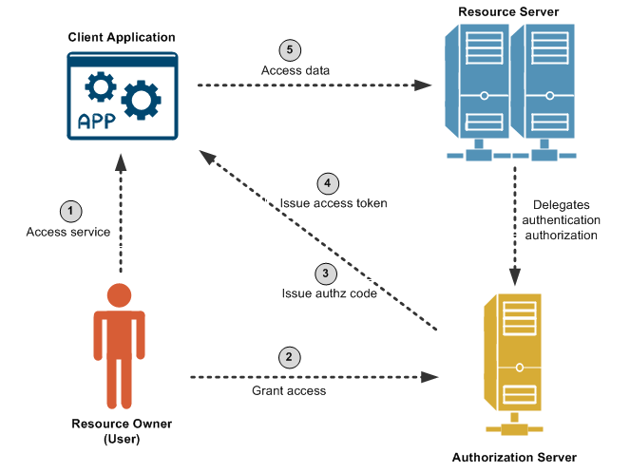
Before UMA, Quick Oauth reminder
Notes:
Moving on from VCs, but before mentioning UMA – going to quick recap oath
Key point is – its about a user being able to control what data is available to what client application, on behalf of themselves

Slide 38
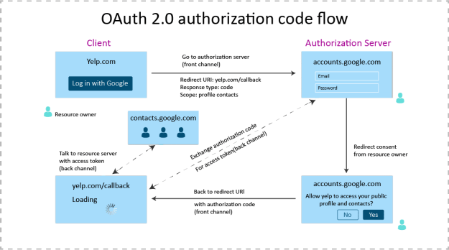
Quick OAuth example
Notes:
Classic example is yelp requesting contact list from google account
With Ouath, the user is consenting to Yelp only having the read access SCOPE for contacts, and nothing else
Yelp cant access email, or you tube history or anything else in the google account

Slide 39
Oauth scopes
Messages.Read
Profile.Write
Health.BloodPressure.Read
Etc etc
Notes:
Oauth has the concepts of scopes
Which are basically just attributes
They can be about the user – profile based scopes
Or in the context of the client application that is accessing data on behalf of the user
The Policy Enforcement then makes decisions based on these scope attributes

Slide 40
Levels of Scope – Keeping things in Context
Alice is 11, Bob is her father
The Account is linked to Alice’s NHS Number
Bob is added as a user to the Account, and with Full Access
Alice, even though its her linked NHS Number, only has Limited Access (due to age).
Alice, only has the Scope:
Messages.Read
Bob has the scope:
Messages.Read.All
This could allow for messages to be sent to Bob, but kept in the context of Alice’s account. Bob could read messages sent to him (that are about Alice), as well as those sent directly to Alice.
Alice could only read messages sent to her.
Notes:
How can proxy utilise this?
With context to scope

Slide 41
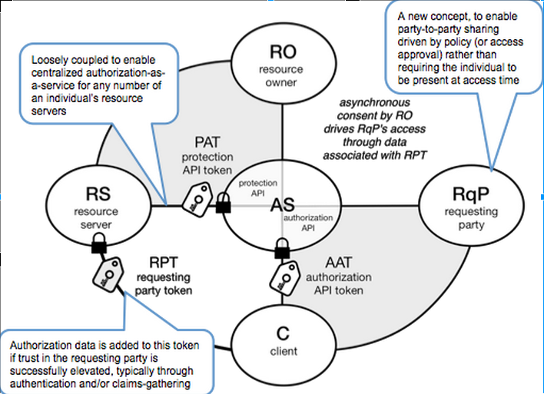
Strand 2: User Managed Access
UMA 2.0 extends the OAuth 2.0 protocol and gives resource owners granular management of their protected resources by creating authorization policies on a centralized authorization server.
The authorization server grants delegated consent to a requesting party on behalf of the resource owner to authorize who and what can get access to their data and for how long.
Who can access what, and from where
RO - “Elderly Parent”
RS - “Simulation of NHS Account API”
AS - New Service
RqP - “Adult”
C - NHS App/NHS.UK
Notes:
Extending Oauth to support the Concept of WHO
A way of using oauth techniques, for the requesting, and consent appove / deny of requests

Slide 42
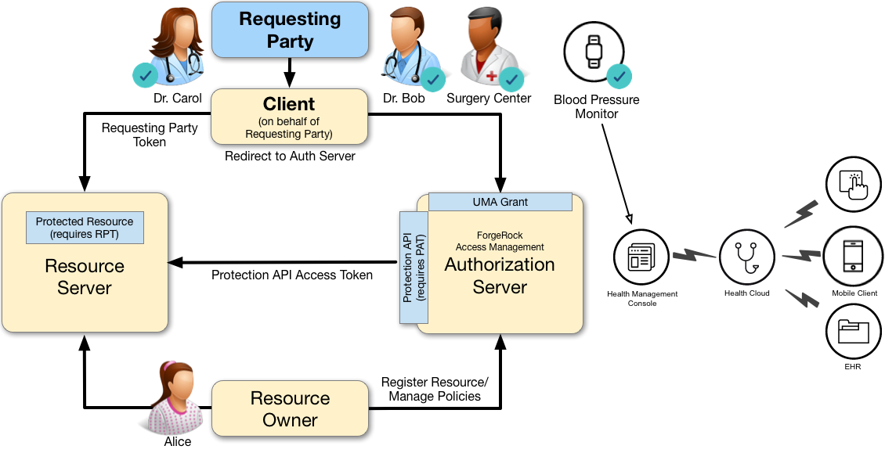
Strand 2: User Managed Access
Notes:
A (US) medical example here, could be useful to explore, but not going to go through it all now

Slide 43
Strand 2: User Managed Access
A resource owner, Alice, is a patient who plans to undergo a medical procedure at a surgery center. Dr. Bob is a specialist who needs read access (i.e., read scope) to Alice's electronic health records in order to operate, and write access (i.e., write scope) in order to add new entries related to the surgery. These records are a resource whose contents have built up over time and to which Alice's regular physician, Dr. Carol, has access already.
Alice, or some party representing Alice, registers her medical health records and sets up permissions using authorization policies, allowing Dr. Bob and Dr. Carol access to her health data. On an online healthcare application, Alice can easily grant consent by clicking a "Share" button to her data, or decline access by clicking a "Deny" button.
UMA also solves managed consent for IoT deployments. For example, Alice will need to be monitored after her operation. Dr. Bob prescribes a smart medical device for Alice, such as a clinical-grade blood pressure monitor, which must be registered by the resource server to place it under the authorization server's protection. The blood pressure monitor sends data to a server that aggregates and transmits the data to external devices, allowing Dr. Bob and Dr. Carol access to Alice's data on their tablets or mobile apps.
AM supports a one-to-many policy that can be shared with many entities, not just targeting a single requesting party. Thus, Alice is able to share her data with Dr. Bob, Dr. Carol, as well as with the clinical and operational employees at the surgery center
Notes:
Will leave the reading through of the scenario to you later

Slide 44
Aims of next phase of work
Understand the reaction of users and staff as to how the process works in reality
Catch problems on a small scale, whilst they are manageable
Gather user stories to support the later engagement of practices which do not currently offer a proxy service, or offer only a reduced service
Bring benefits to staff and users in the short-term
Notes:
Strand 1 –
focus on benefit now
A true MVP – lets just get something working that supports the concept of proxy

Slide 45
Strand 2: Next phase and Post June
Working with other organisations with regard to VC’s
“Account Core” – “Account Data” is “in progress”, but need to work with Account at E and D over controlling access to that data
Primary Care data – can we work with them to have account expose data? Or will we be looking at how we can update GPIT system authorisation rules?
IAM – need involvement
At the moment, fairly isolated in CE scoping this –
What is going on else where?
What can support this
Open to all input around what exists / doesn’t exist – etc

